Slide 1
Mini Project- Team 8 Document Scanner with Air Drawing Using Computer Vision
Guide: Navyashree T M
Members:
Keerthana TV(1DS18CS718)
Rhuthu Hegde(1DS18CS731)
Shaik Iftekhar Ahmed(1DS18CS736)
Charita(1DS19CS421)

Slide 2
Abstract
This project intends to make drawing or annotating hands free by using Hand tracking modules and virtually drawing on a Scanned document and is a major application of Computer Vision. The document is captured real time and stored in the system, which is then cropped to remove the unwanted edges and background and saved again. It uses edge detection and Canny detection and does automatic corner detection, image sharpening, and color thresholding. The hand tracking is module is used to detect the finger tips from the web camera for drawing on the Canvas using the Index finger. Two fingers are used for color selection and Index finger is used to annotate on the document making it contact-less and easy.

Slide 3
Concepts
Scanner
The scanner module has been implemented with the help of Open CV.
Open CV(Open source computer vision library) is an open source computer vision and machine learning software library. This library has more than 2500 optimized algorithms that can be used to detect and recognise faces, identify objects, classify human actions in videos, track moving objects, extract 3D models etc.
Building a document scanner using OpenCV can be accomplished in three steps
Step 1: Detect edges
Step 2: Use the edges detected to find the contour(outline) representing the piece of paper being scanned.
Step 3: Apply perspective transform to obtain top down view of the document
We use Canny edge detection algorithm for the edge detection process
Canny edge detector is a popular multi stage algorithm developed by John F. Canny. The different stages are as follows:

Slide 4
Scanner
Stage 1:Noise Reduction
Edge detection is susceptible to noise in the image as it uses derivatives, hence the first we remove the noise in the image using a 7X7 Gaussian filter.
Smaller the kernel, less visible is the blur.
Stage 2: Find the intensity gradient of the image:
Edge corresponds to change in pixel intensity.
Smoothened image is filtered with a Sobel Kernel in both horizontal and vertical direction o get first derivative in horizontal direction ( Gx) and vertical direction ( Gy). From these two images, we find edge gradient and direction for each pixel.
Stage 3: Non Maximum Suppression:
Ideally edges must be thin, so we thin out the thick edges in this stage.
Stage 4:Double Threshold:
Identifies Strong(high intensity), Weak(Low intensity) and non relevant pixels.
Stage 5:Hysterisis Thresholding
This stage decides which are all edges are really edges and which are not.
We take two threshold values, minVal and maxVal. Any edges with intensity gradient more than maxVal are sure to be edges and those below minVal are sure to be non-edges, and are discarded.
Those that lie between these two thresholds are classified edges or non-edges based on their connectivity. If they are connected to "sure-edge" pixels, they are considered to be part of edges. Otherwise, they are discarded.

Slide 5
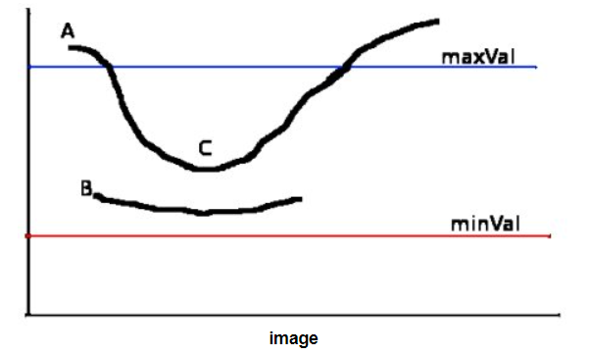
Scanner
The edge A is above the maxVal, so considered as "sure-edge". Although edge C is below maxVal, it is connected to edge A, so that also considered as valid edge and we get that full curve. But edge B, although it is above minVal and is in same region as that of edge C, it is not connected to any "sure-edge", so that is discarded. So it is very important that we have to select minVal and maxVal accordingly to get the correct result.

Slide 6
Scanner
We then need to perform contour detection. A contour is a set of boundary pixels that all have the same intensity and colour.’
OpenCV makes it really easy to find and draw contours in images. It provides two simple functions:
findContours()
drawContours()
We use the perspective Transform and Warp perspective functions to achieve the top down view of scanned image.
Finally we use Adaptive Threshold to get the black and white image.

Slide 7
Air Drawing
The ability to perceive the shape and motion of hands can be a vital component in improving the user experience across a variety of technological domains and platforms. For example, it can form the basis for sign language understanding and hand gesture control, and can also enable the overlay of digital content and information on top of the physical world in augmented reality. While coming naturally to people, robust real-time hand perception is a decidedly challenging computer vision task, as hands often occlude themselves or each other (e.g. finger/palm occlusions and hand shakes) and lack high contrast patterns.
The library which has been majorly used for this task is Media Pipe by Google. Media Pipe Hands is a high-fidelity hand and finger tracking solution. It employs machine learning (ML) to infer 21 3D landmarks of a hand from just a single frame.

Slide 8
Air Drawing
After capturing the video from the web camera the palm is detected at first and after the palm detection over the whole image our subsequent hand landmark model performs precise key point localization of 21 3D hand-knuckle coordinates inside the detected hand regions via regression, that is direct coordinate prediction. The model learns a consistent internal hand pose representation and is robust even to partially visible hands and self-occlusions.
Hand detector class has 4 functions defined namely, findHands(), findPosition(), fingersUp() and findDistance(). On running the main function findHands() function is executed, to detect the hands in the camera. Following which findPosition() is executed to find the coordinates of the hand. fingersUp() function is used to detect if the fingers are raise and their tips. findDistance() gives a rectangle between the 2 fingers when it is raised by calculating distance between them and a circle when only the index finger is raised.

Slide 9


Slide 10
Air Drawing
The hands are detected with a particular ‘detectionCon’ and a maximum of one hand is detected at a time. There are two signs which has to be detected.
Selection mode: When 2 fingers are up, it acts as a selection mode and helps us select the colours from the colour palette. The rectangle then denotes the colour which has been selected.
Drawing mode: When only the index finger is up, it’s the drawing mode and it is denoted by the circle of the same colour which is used to highlight on the image.
fingersUp() function is used to detect the number of fingers raised and gives the modes as an output.

Slide 11
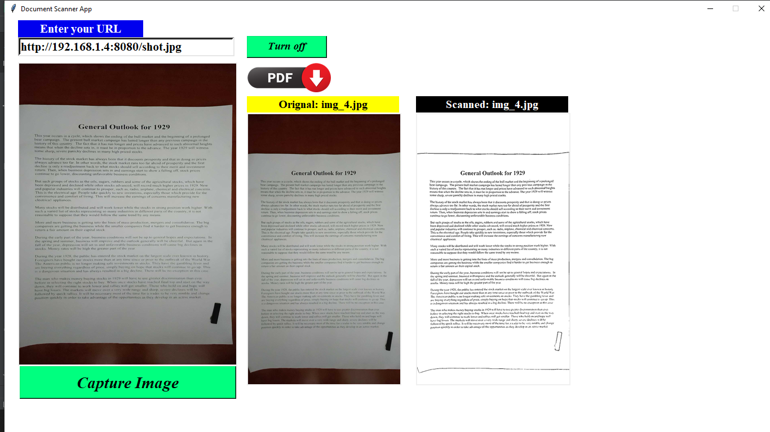
UI Screen Shots
Scanner capturing the image in real time

Slide 12
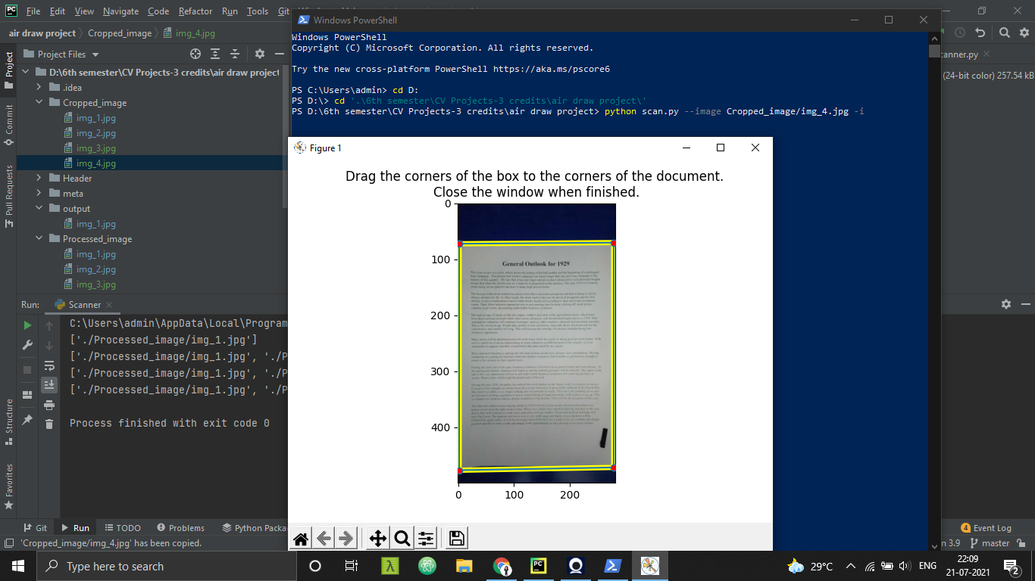
Cropping the image to suit our needs

Slide 13
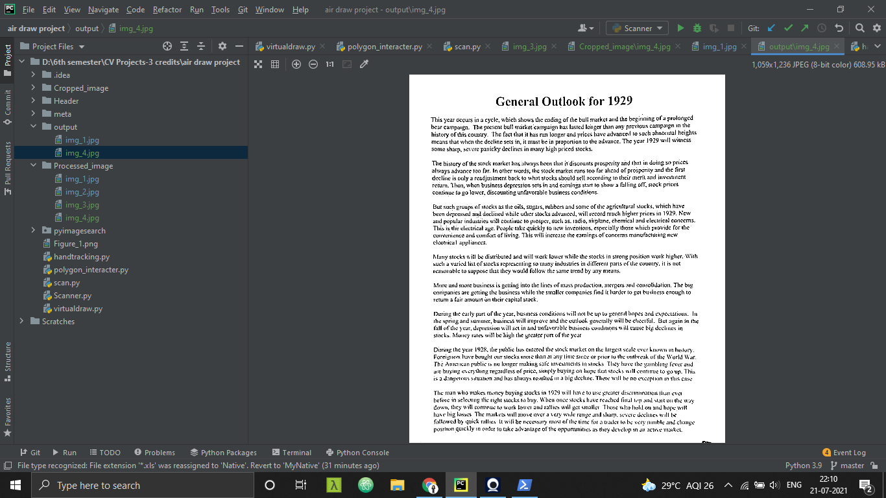
Output image after the scanning process using edge detection

Slide 14
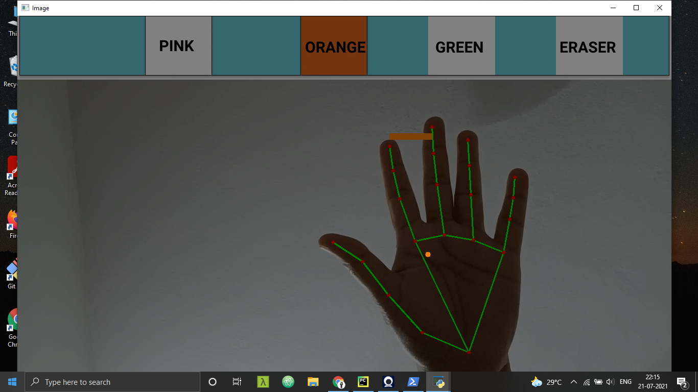
Hand tracking using MediaPipe to highlight all the fingers and draw circles.

Slide 15
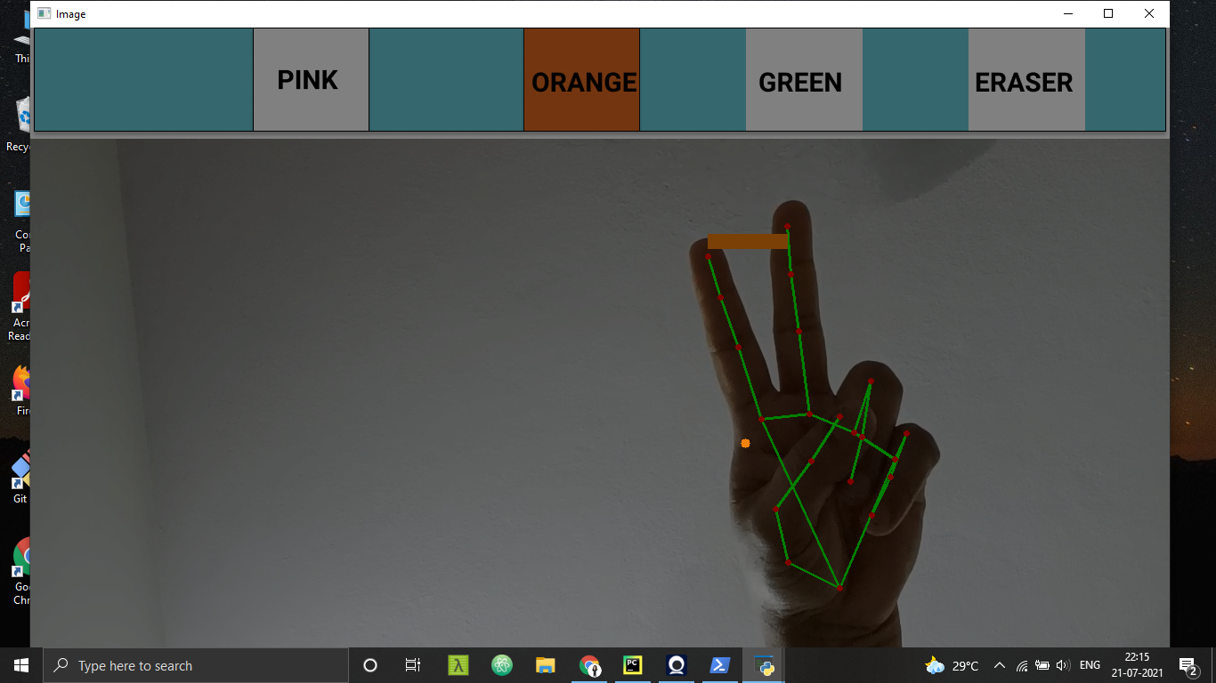
Selection mode indication shown using the rectangular box to select colors

Slide 16
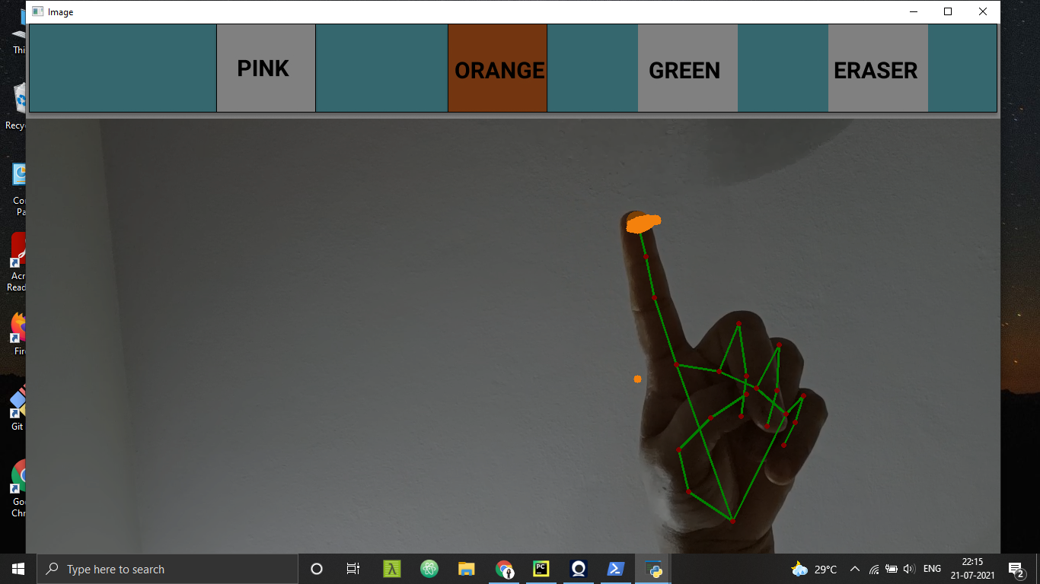
Drawing mode indication shown using the circle

Slide 17
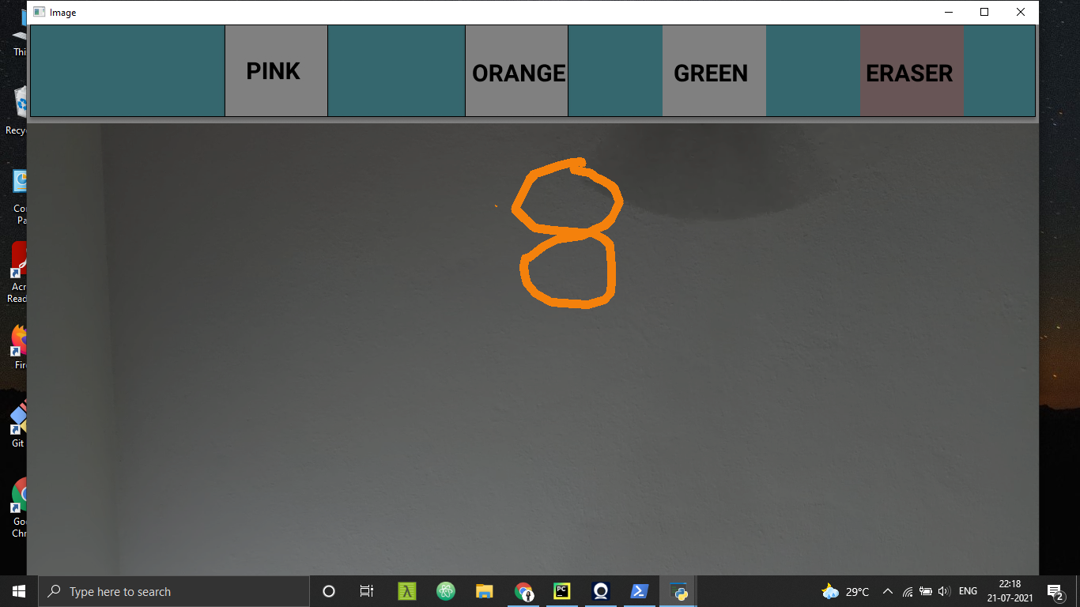
Image with the drawing

Slide 18
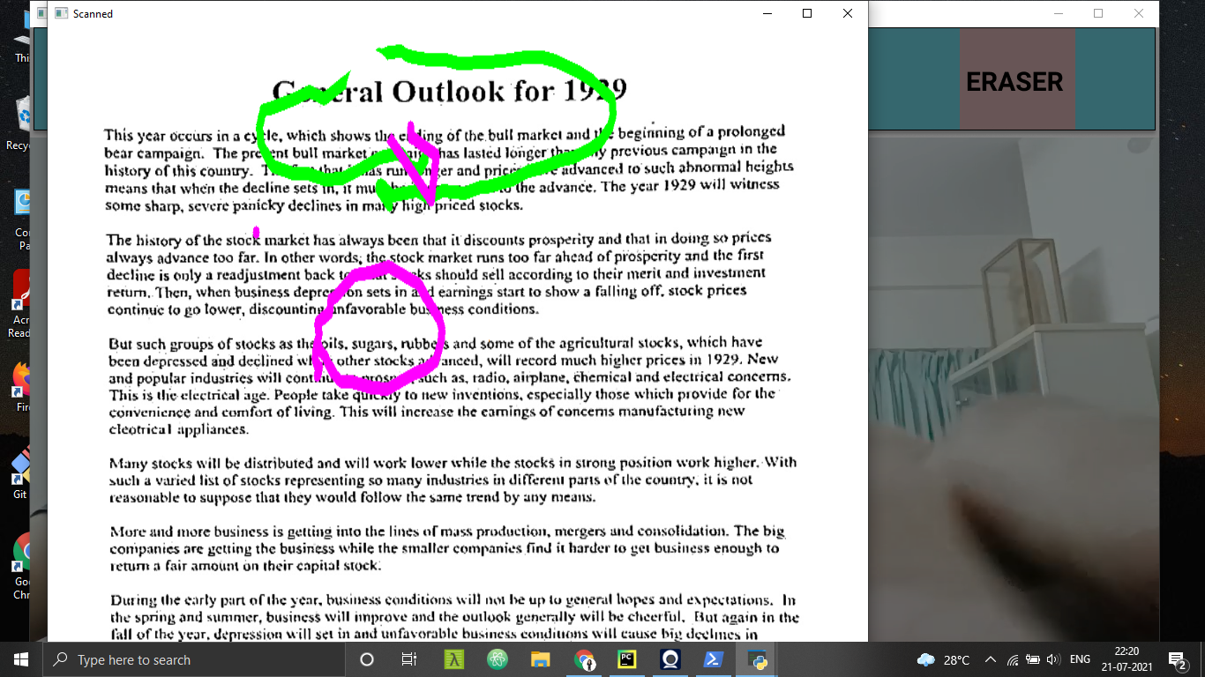
Drawing on the scanned document to highlight the text.

Slide 19
References
https://google.github.io/mediapipe/solutions/hands.html
https://www.analyticsvidhya.com/blog/2021/07/building-a-hand-tracking-system-using-opencv/
https://www.geeksforgeeks.org/create-air-canvas-using-python-opencv/

